Slide 1
Object Classification in more than one Language
Project By:-
Anshuman Sekhar Dash
PruthiRaj Marndi
Swagat Kumar Dora
Sanjay Tudu
Guided By:-
D K Swain
Asst. Professor CSEA
IGIT Sarang

Slide 2
Preparing the Model
For training of deep Learning model ,We used the concept of transfer learning
We used MobileNet-v3 object classification model and retrained it to detect and classify 28 objects (at present) using image datasets gathered.
MobileNet is a a small efficient convolutional neural network which can differentiate between 1,000 different classes, like Dalmatian or dishwasher

Slide 3
Preparing The Model(Contd.)
After retraining 2 files are generated a graph.pb which contains a version of the selected network with a final layer retrained on our categories.
and label.txt which is a text file containing labels.
This model can now successfully classify images into 28 categories with probability of matching.

Slide 4
Preparing The Model(Contd.)
Retraining script can be configured with parameters like learning rate and training steps.
The scripts are written in python and trained using tensorflow deep learning framework

Slide 5
Developing the Application
Using android studio ,application was made which contains a user selection of language.
The application uses the phone camera to look for objects.

Slide 6
Merging the model with app
The graph generated after retraining cannot be used as such in a mobile device for which the graph.pb file was converted to tflite format which optimises by pruning unused graph-nodes, and performance improvements by joining operations into more efficient composite operations

Slide 7
Merging the model with app(Contd.)
The labels files was added with English,Hindi and odia language into the application
The lite model was also added into the application and power tensorflow for android library was used to run the model.

Slide 8
Further Steps
Adding more languages and classes of objects
Word pronunciation feature for each language.

Slide 9
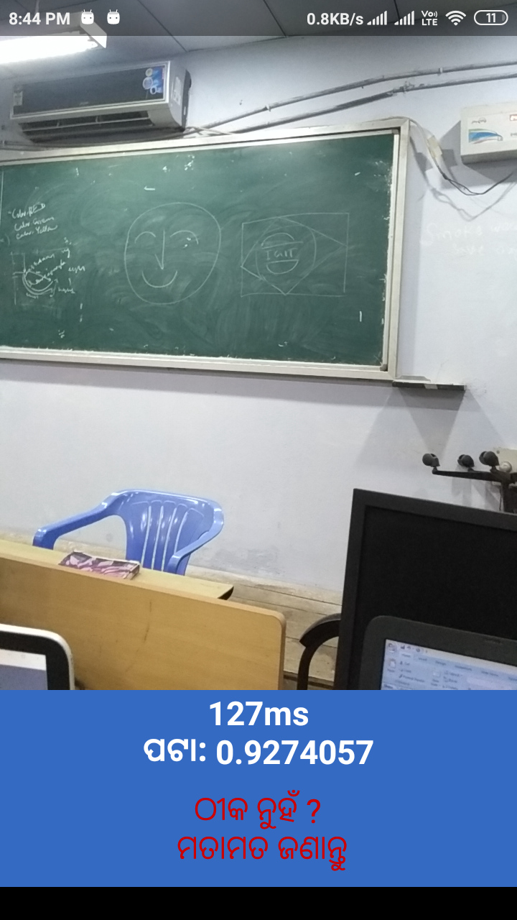

Slide 10
Class Of Objects
Pomegranate
Backpack
Bellpepper
Board
Broccoli
Corn
Daisy
Dandelion
Desk
Flowervase
Guava
Keys
Mango
Marigold
Mobilephones
Onion
Papaya
Pen
Pineapple
Podium
Potato
pumpkin
Purse
Roses
Spectacles
Sunflowers
Tulips
wallet

Slide 11
References
MobileNets: Efficient Convolutional Neural Networks for Mobile Vision Applications by Andrew G. Howard, Menglong Zhu
Tensorflow.org

